Slide 1
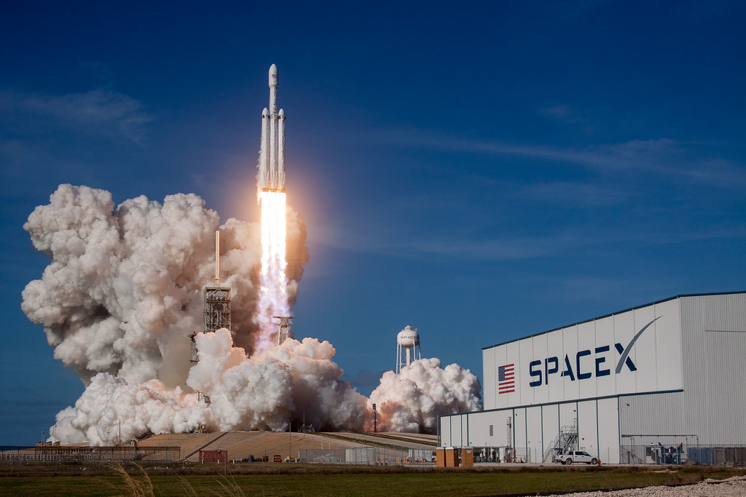
IBM Data Science Capstone Project – SpaceY Price for Each Launch
Denise Jeannie Marti
06/12/2023

Slide 2
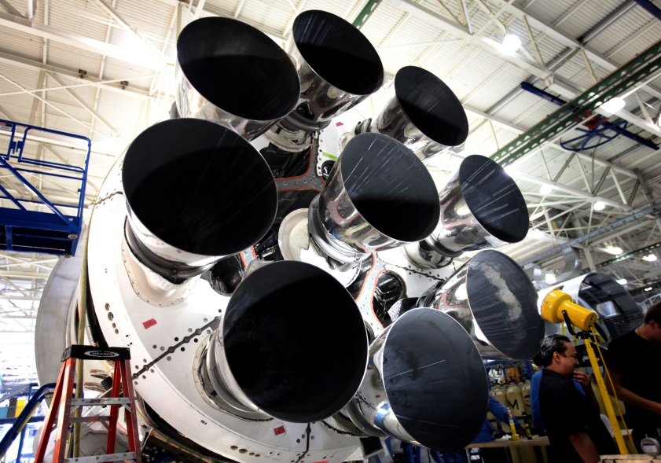
OUTLINES
01
05
Executive Summary
Discussion
Findings & Implications
02
Introduction
06
Conclusion
03
Methodology
07
04
Appendix
Results
Visualization - Charts
Dashboard

Slide 3
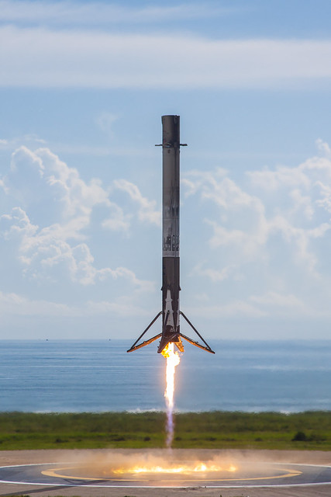
EXECUTIVE SUMMARY
Data Collection using API | We generate a get request to the SpaceX API and a basic data organization and formatting.
Data Collection with Web Scraping | Web data scraping to collect historical Falcon 9 launch records from Wikipedia.
Data Wrangling | Find some patterns in the data and determine what the label would be for training supervised models.
Exploratory Data Analysis with SQL | Analyze first-stage feedback data to determine the cost of a launch.
Exploratory Data Analysis with Data Visualization | Conducting exploratory data analysis and resource engineering to predict the successful return of the first stage.
Interactive Visual Analytics with Folium | Interactive visual analytics using Folium.
Machine Learning Prediction (Predictive analysis - Classification) | Creating a machine learning pipeline to predict whether the former will be successful in return.

Slide 4
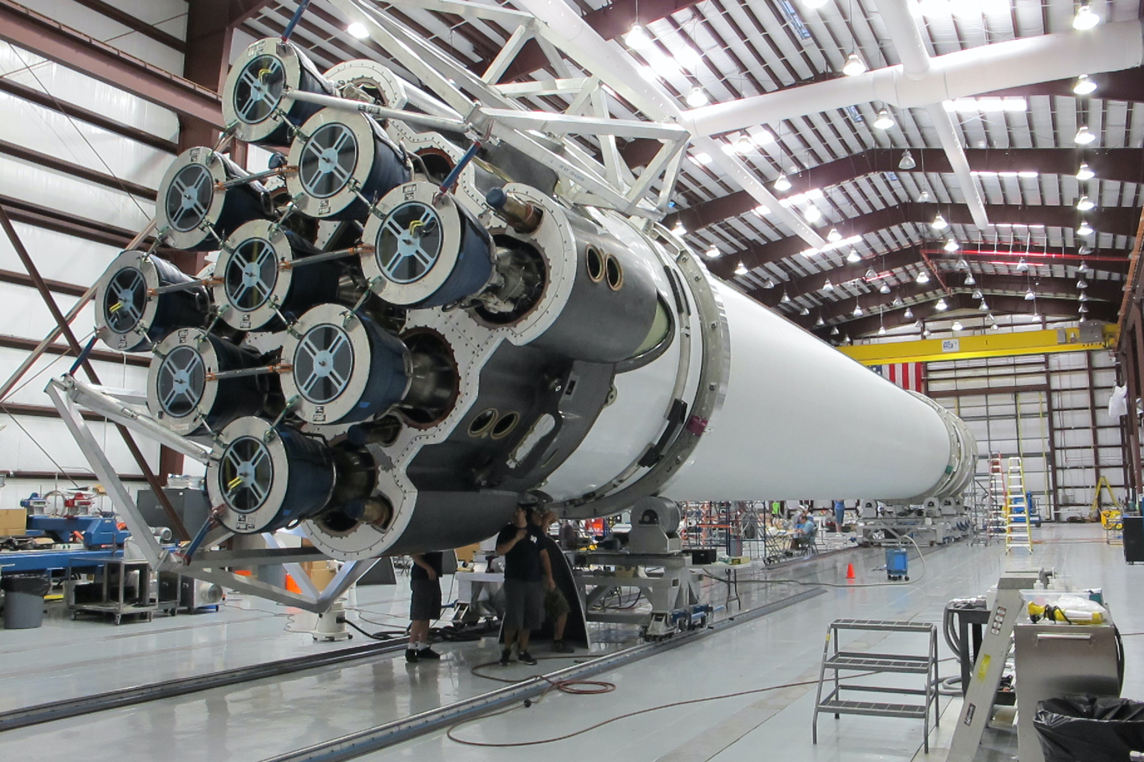
INTRODUCTION
As a data scientist working for a new rocket company, my goal is to determine the price for each launch of SPACE X.
• Collecting information about the Space;
• Demonstrating data through dashboards for the team;
• Seeking data on reuse of the first stage of SpaceX rockets.
• Training a machine learning model to determine whether or not the first stage successfully lands using the public information.

Slide 5
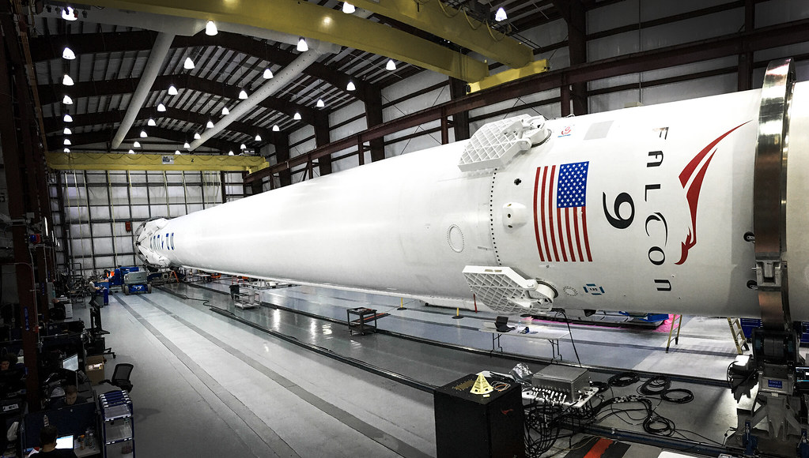
METHODOLOGY

Slide 6
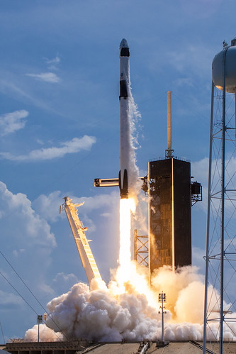
METHODOLOGY
SpaceX launch datasets collected via SpaceX REST API, giving us data such as:
Launch, rockets used, useful carga, launch sites, launch and landing specifications and whether or not there was success in returning the first phase of the rocket.
Using this data we can predict what are the chances of successful return of the first phase of the rocket.
SpaceX REST API endpoints, or URLs, start with api.spacexdata.com/v4/.
Another data source to obtain Falcon 9 launch data is Wikipedia using Beauty Soup.

Slide 7
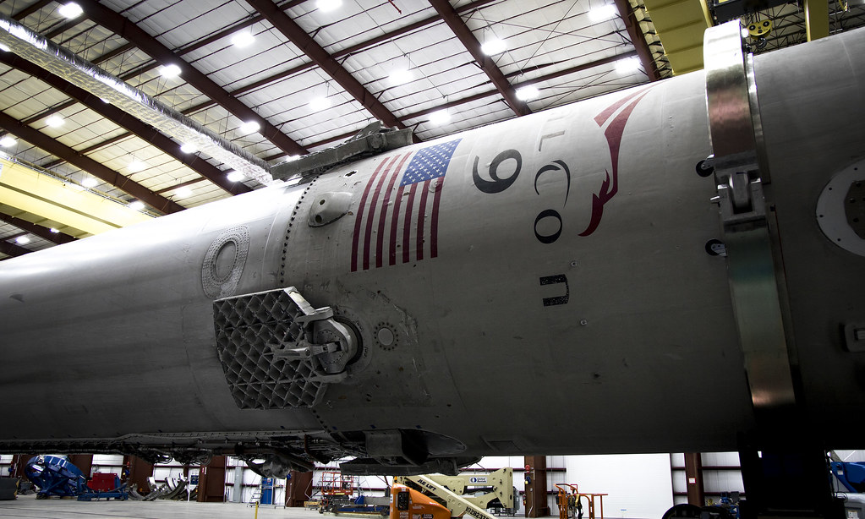
DATA COLLETION – SPACEX API
• Request data from SpaceX API (rocket launch data) ;
• Decode response using .json() and convert to a dataframe using .json_normalize();
• Request information about the launches from SpaceX API using custom functions;
• Create dictionary from the data;
• Create dataframe from the dictionary;
• Filter dataframe to contain only Falcon 9 launches;
• Replace missing values of Payload Mass with calculated .mean()
• Export data to csv file.

Slide 8
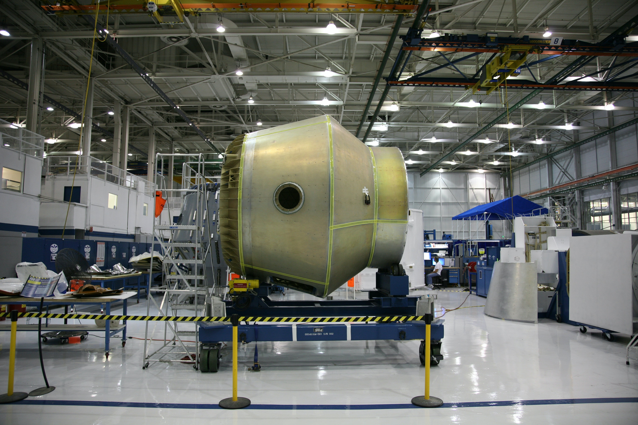
DATA COLLECTION - Web Scraping
• Request data (Falcon 9 launch data) from Wikipedia;
• Create BeautifulSoup object from HTML response;
• Extract column names from HTML table header;
• Collect data from parsing HTML tables ;
• Create dictionary from the data ;
• Create dataframe from the dictionary ;
• Export data to csv file.

Slide 9
DATA WRANGLING
Perform EDA and determine data labels;
Calculate number of:
launches for each site, occurrence of orbit, and occurrence of mission outcome per orbit type;
Create binary landing outcome column (dependent variable)
Export data to csv file

Slide 10
DATA WRANGLING– Landing Outcoming
Landing was not always successful.
True Ocean: successful landing to a specific region of the ocean.
Basic Information:
False Ocean: an unsuccessful landing to a specific region of ocean;
True RTLS: had a successful landing on a ground pad;
False RTLS: an unsuccessful landing on a ground pad;
True ASDS: had a successful landing on a drone ship;
False ASDS: an unsuccessful landing on drone ship;
Outcomes converted into 1 for a successful landing and 0 for an unsuccessful landing.

Slide 11
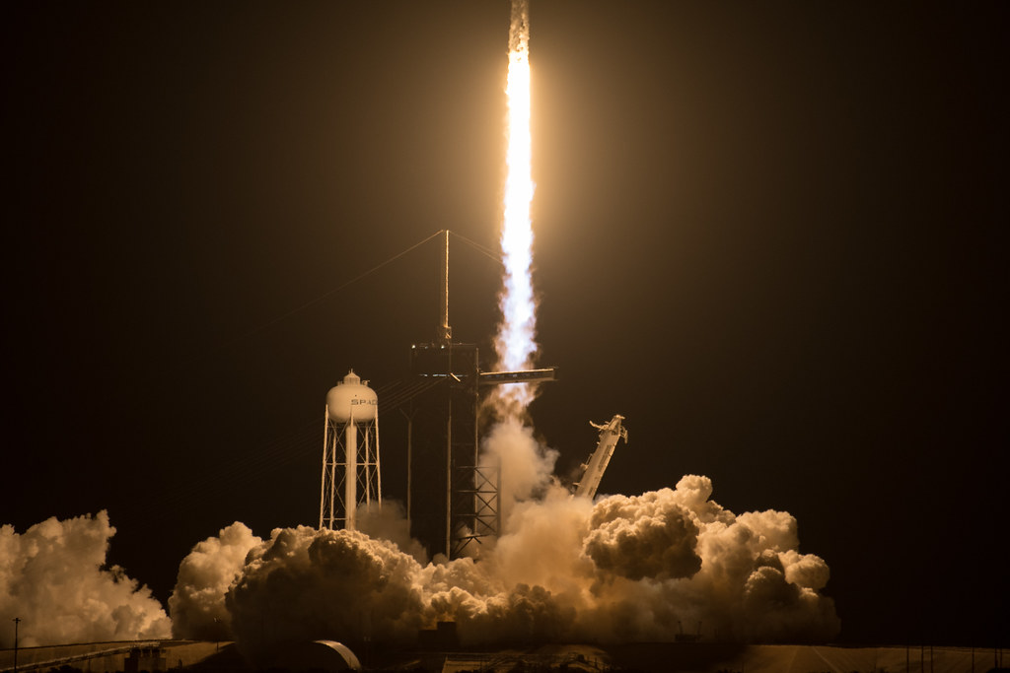
EDA WITH VISUALIZATION - CHARTS
Flight Number vs. Payload
Flight Number vs. Launch Site
Payload Mass (kg) vs. Orbit type
Payload Mass (kg) vs. Launch Site
Orbit VS. Flight Number
Orbit VS. Payload Mass
Payload VS. Orbit Type

Slide 12
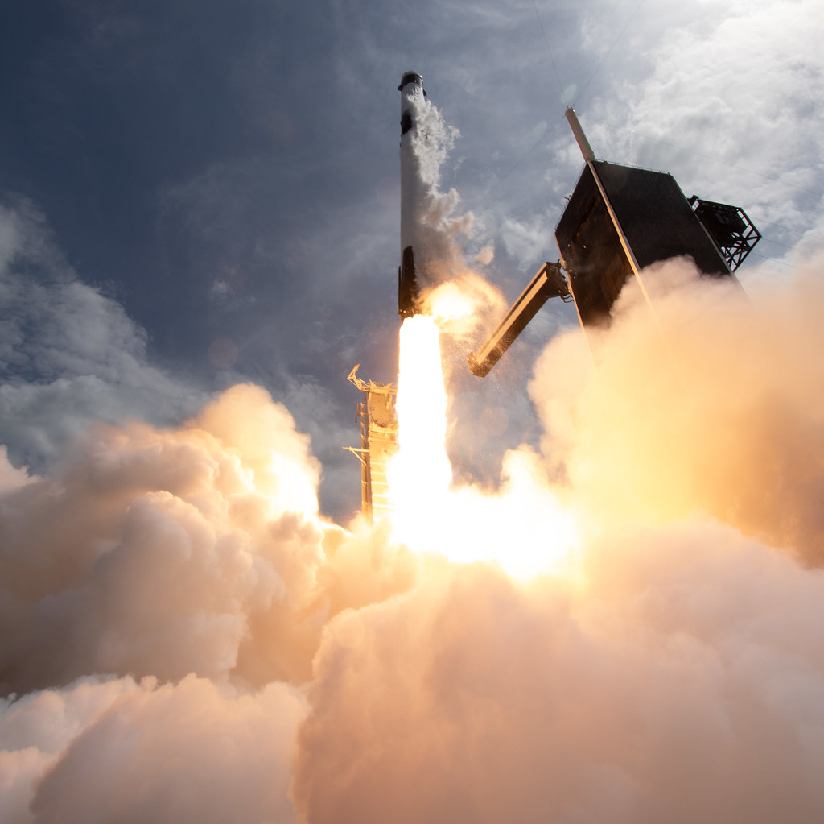
EDA WITH SQL
SQL queries were used to get answers on the dataset such as:
Display the names of unique launch sites in the space mission;
Display 5 launch site records that start with the string 'KSC’;
Display the total mass of payload carried by NASA-Launched thrusters (CRS);
Display the average load mass carried by the F9 v1.1 booster version;
Date of first successful landing on ground pad
List names of boosters that were successful on the ground pad with charge mass greater than 4000 and less than 6000;
Total list of successful and unsuccessful missions;
List the names of booster versions that carried the maximum payload mass;
Failed landing outcomes on drone ship, their booster version and launch site for the months in the year 2015;
Count of landing outcomes between 2010-06-04 and 2017-03-20 (desc) ;
Classification.

Slide 13
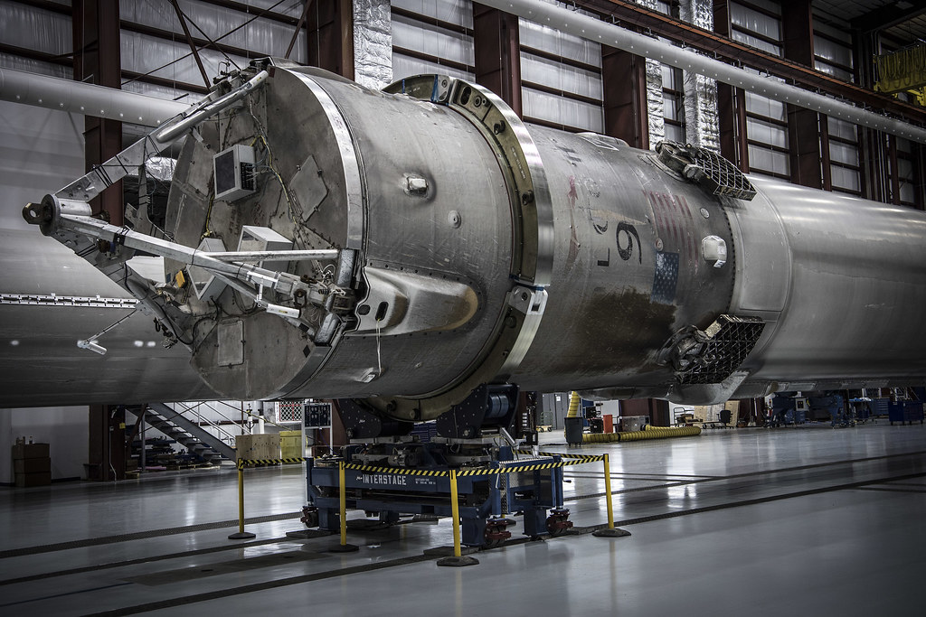
MAP WITH FOLIUM
Markers Indicating Launch Locations
Added blue circle at NASA's Johnson Space Center coordinate with a pop-up label showing name and its latitude and longitude coordinates.
Added red circles to all launch location coordinates with a pop-up label showing name and their latitude and longitude coordinates.
Map with folium
Colored launch results markers;
Added colored markers of successful (green) and unsuccessful (red) launches to each launch site to show which launch sites have high success rates;
Distances between a launch site and surroundings;
Added colored lines to show the distance between the CCAFS SLC40 launch site and its proximity to nearby coastline, railway, highway and city.

Slide 14
DASHBOARD WITH PLOTY DASH
Dropdown list: with launch sites to allow user to select all launch sites or a particular launch site.
Dashboard with Plotly Dash: Payload mass range slider to allow user to select payload mass range.
Pie Chart: Showing successful launches to allow the user to see successful and unsuccessful launches as a percentage of the total.
Scatter plot: showing payload mass x success rate by boost release to allow user to see correlation between payload and launch success.

Slide 15
PREDICTIVE ANALYSIS
Create a NumPy array with Pandas from the Class column;
Standardize data with StandardScaler by fitting and transforming data;
Split the data using train_test_split;
Create a GridSearchCV object with cv=10 for parameter optimization;
Apply GridSearchCV in different algorithms: logistic regression
(LogisticRegression()), support vector machine (SVC()), decision tree;
(DecisionTreeClassifier()), K-nearest neighbor (KNeighborsClassifier());
Calculate the accuracy of the test data using .score() for all models;
Evaluate the confusion matrix for all models;
Identify the best model using SVM, Classification Trees and Logistic Regression

Slide 16
RESULTS

Slide 17
RESULTS SUMMARY
Exploratory Data Analysis | Success in releases improved over time; • KSC LC-39A has the highest success rate among landing sites • ES-L1, GEO, HEO and SSO orbits have a 100% success rate
Visual Analytics | Launch sites are mostly near the equator and near the coast; Launch sites are far enough away to avoid damage (city, highway, rail) should a launch fail, but far enough away to bring people and materials to support launch activities.
Predictive Analytics | Decision Tree model is the best predictive model for the dataset.

Slide 18
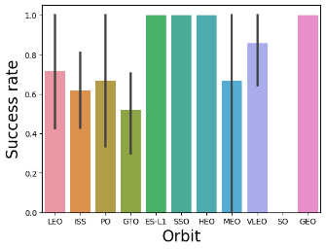
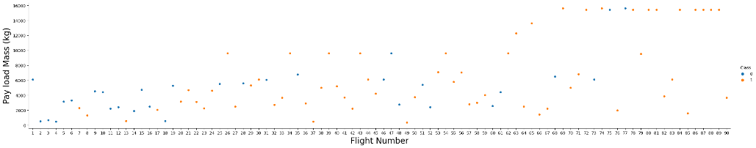
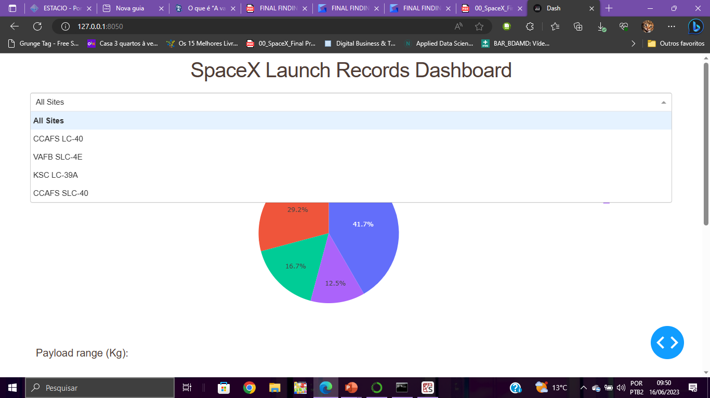
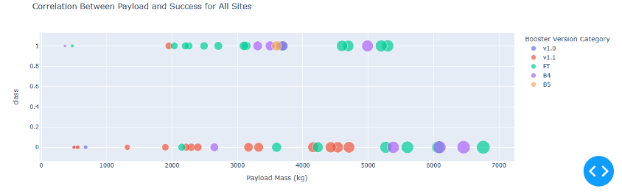
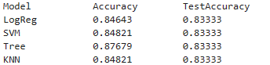
RESULTS SUMMARY cont.
EDA Results
Int. Analytics demo
Predictive Results

Slide 19
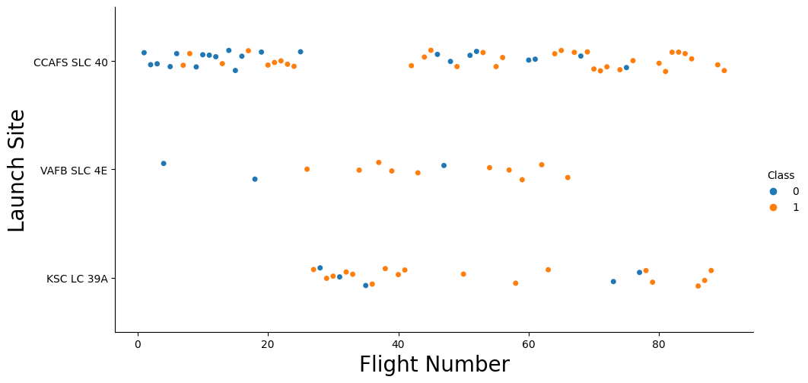
Flight Number vs. Launch Site
Earlier flights had a lower success rate (blue = fail(0))
Later flights had a higher success rate (orange = success(1))
Around half of launches were from CCAFS SLC 40 launch site.
For launch site ‘KSC LC 39A’, it takes at least around 25 launches before a first successful launch.

Slide 20
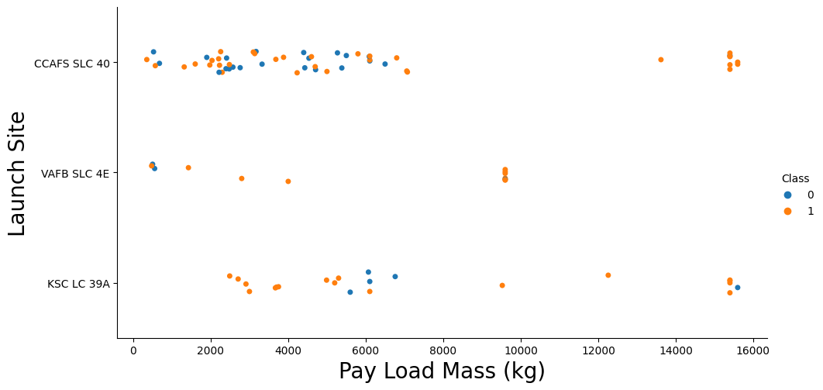
PAYLOAD VS. LAUNCH SITE
Typically, the higher the payload mass (kg), the higher the success rate .
Percentage of successful launch increases for launch site ‘VAFB SLC 4E’ as the payload mass increases.
Most launces with a payload greater than 7,000 kg were successful .
KSC LC 39A has a 100% success rate for launches less than 5,500 kg .
For launch site ‘VAFB SLC 4E’, there are no rockets launched for payload greater than 10,000 kg.

Slide 21
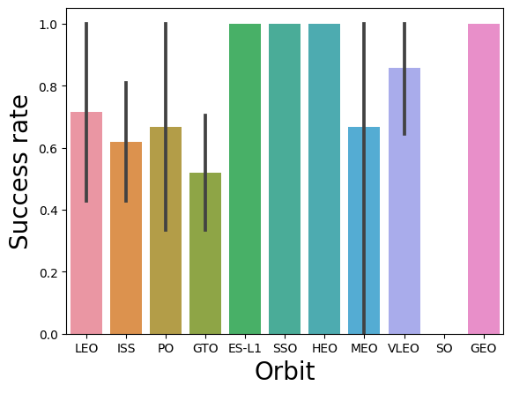
SUCCESS RATE VS. ORBIT TYPE
100% Success Rate: ES-L1, GEO, HEO and SSO
50%-80% Success Rate: GTO, ISS, LEO, MEO, PO
0% Success Rate: SO
Orbits ES-LI, GEO, HEO, and SSO have the highest success rates.

Slide 22
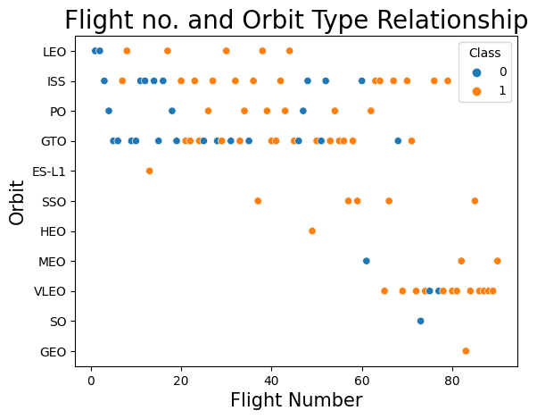
FLIGHT NUMBER VS. ORBIT
For most orbits (LEO, ISS, PO, SSO, MEO, VLEO) successful landing rates appear to increase with flight numbers
This relationship is highly apparent for the LEO orbit
There is no relationship between flight number and orbit for GTO
For orbit VLEO, first successful landing (doesn’t occur until 60+ number of flights

Slide 23
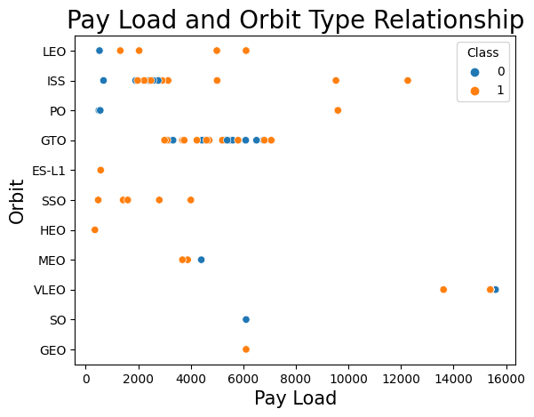
PAY LOAD VS. ORBIT
Successful landing rates appear better with pay load for orbits LEO, ISS and PO.
• The GTO orbit has mixed success with heavier payloads.

Slide 24
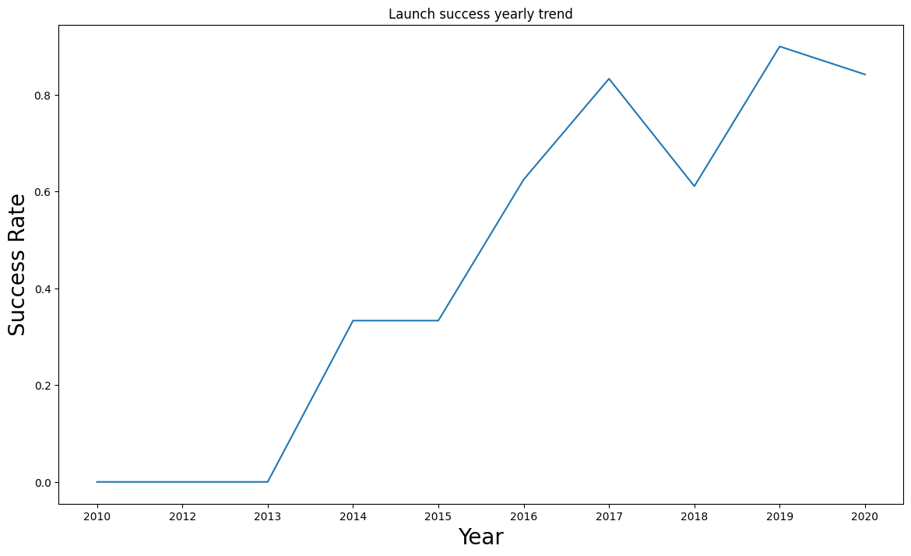
LAUNCH SUCCESS YEARLY TREND
Success rate increased by about 80% between 2013 and 2020
The success rate improved from 2013-2017 and 2018-2019
The success rate decreased from 2017-2018 and from 2019-2020
Overall, the success rate has improved since 2013

Slide 25
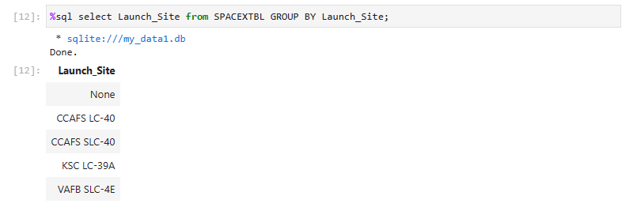
LAUNCH SITE INFORMATION

Slide 26
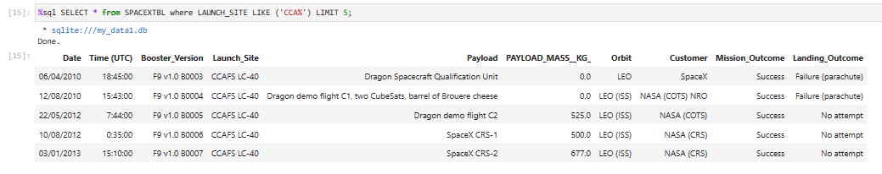
LAUNCH SITE INF. WITH CCA

Slide 27
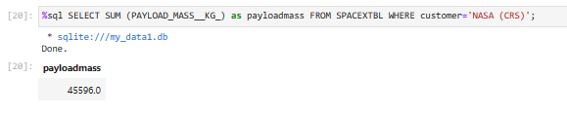

PAYLOAD MASS
Total Payload Mass (kg) carried by boosters launched by NASA (CRS)
Average Payload Mass (kg) carried by booster version F9 v1.1

Slide 28
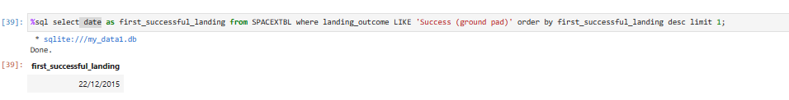
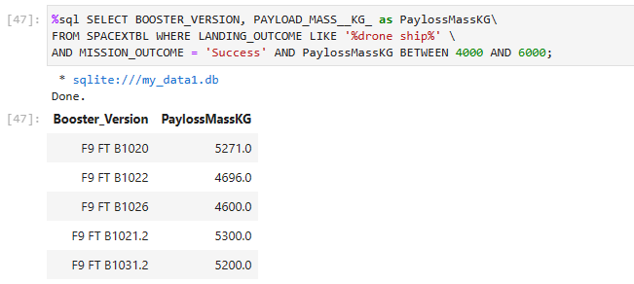
FIRST SUCCESSFUL LANDING & INFOS
1st Successful Landing in Ground Pad
Booster Drone Ship Landing

Slide 29
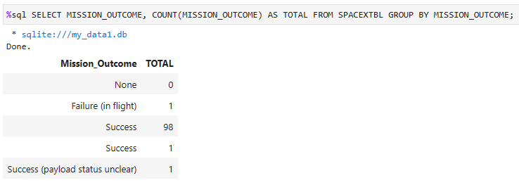
TOTAL NUMBER OF SUCCESSFUL AND FAILED MISSION OUTCOMES

Slide 30
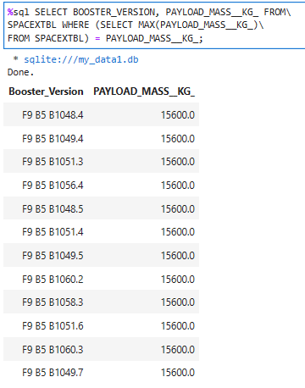
BOOSTERS
The query returned the maximum mass by versions where the maximum is 15600.

Slide 31
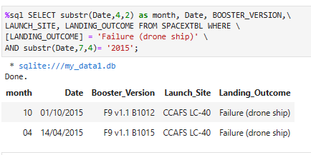
FAILED LANDINGS ON DRONE SHIP
The query lists landing outcome, booster version, and the launch site where landing outcome is failed in drone ship and the year is 2015.

Slide 32
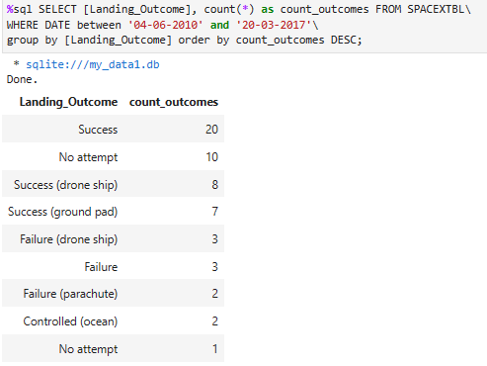
COUNT OF SUCCESSFUL LANDINGS
Count in descending order of landing results between 04-06-2010 and 20-03-2017.

Slide 33
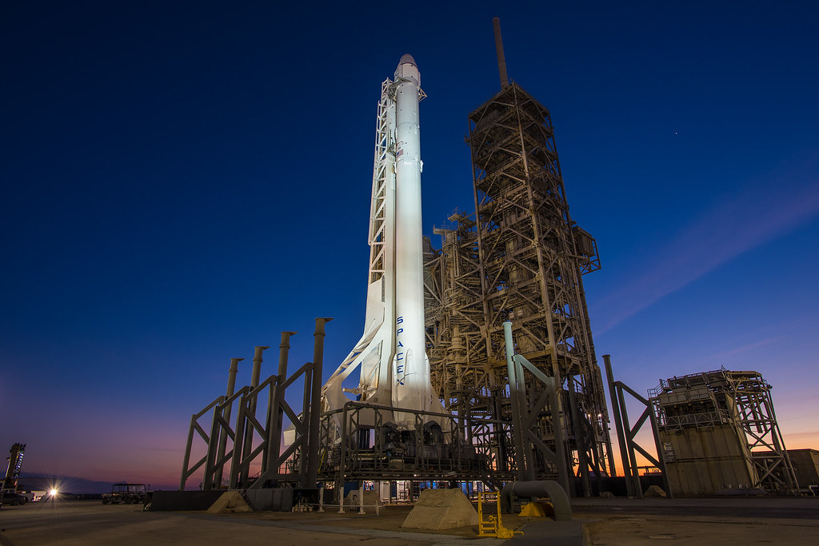
LAUNCH SITE ANALYSIS

Slide 34
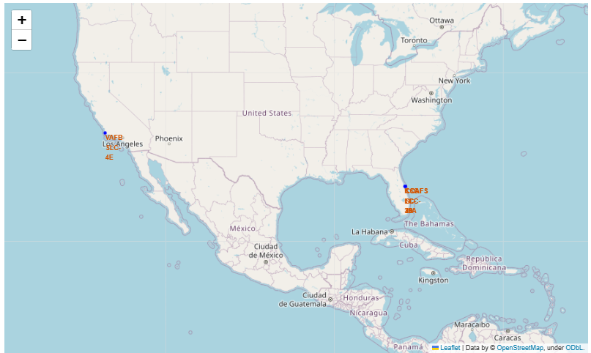
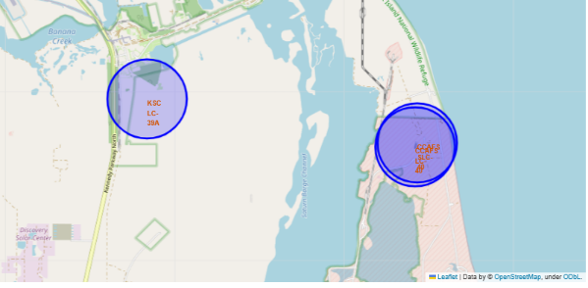
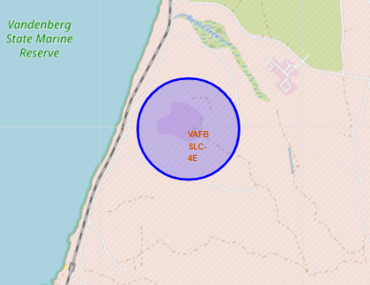
LAUNCH SITE ANALYSIS
Fig 2 – Zoom View: CCAFS LC-40 (FL), KSC LC-39A (FL) e CCAFS SLC-40 (FL).
Fig 3 – Zoom VAFB SLC-4E (CA)
Fig 1 – Global View
The closer the launch site is to the Equator, the greater the Earth's natural thrust which, due to the rotational speed, helps to save on spending on fuels and boosters for a progressive orbit.

Slide 35
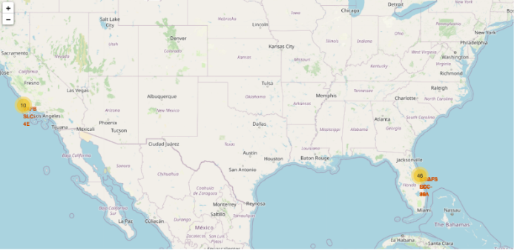
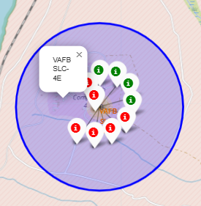
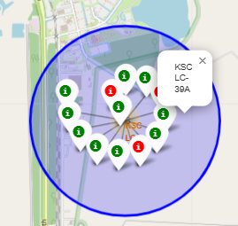
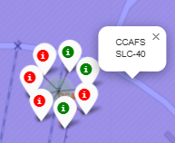
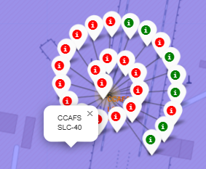
LAUNCH OUTCOMES
The picture below are zoom each site displaying success (green) and failure (red) markers.
Looking at each sitemap, the KSC LC-39A Launch Site has the most successful launches.
US map with all Launch Sites

Slide 36
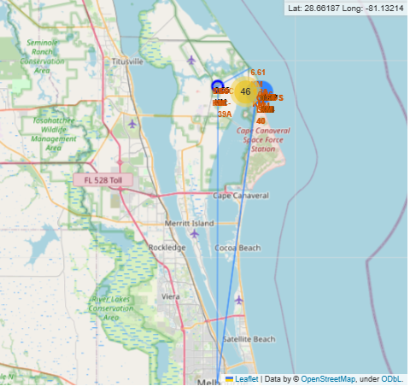
DISTANCE TO PROXIMITIES
CCAFS SLC-40
0.86 km from nearest coastline
1.38 km from nearest railway
56.82 km from Melbourne

Slide 37

DASHBOARD

Slide 38
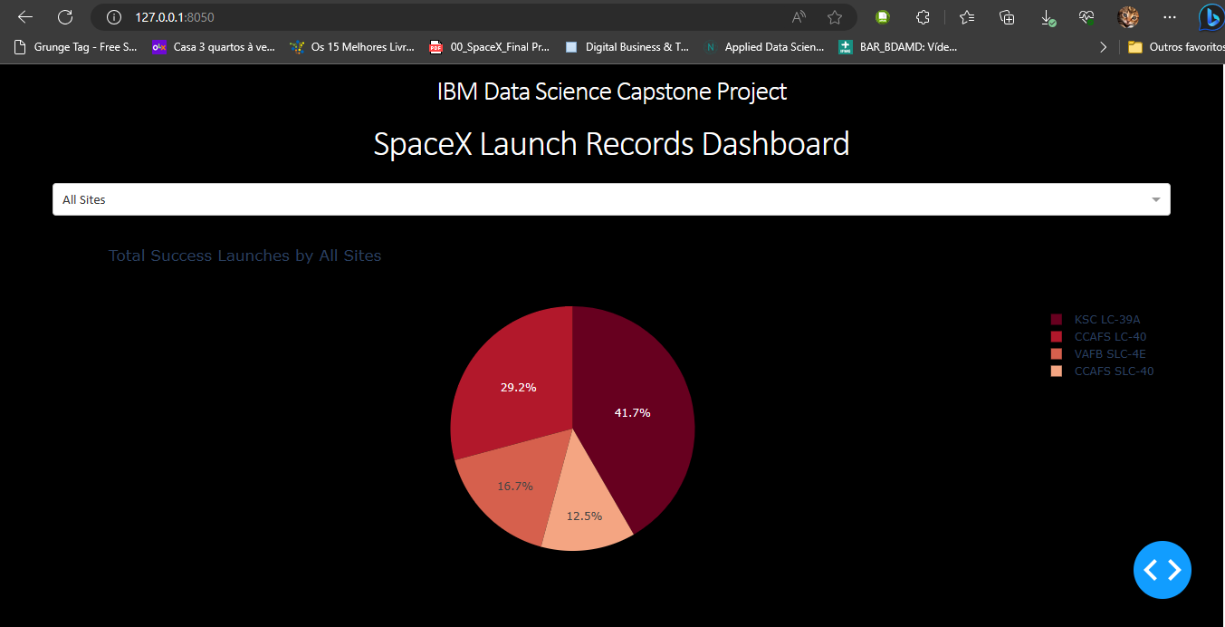
The KSC LC-39A has 41.7% of the most successful launches when compared to the other sites.

Slide 39
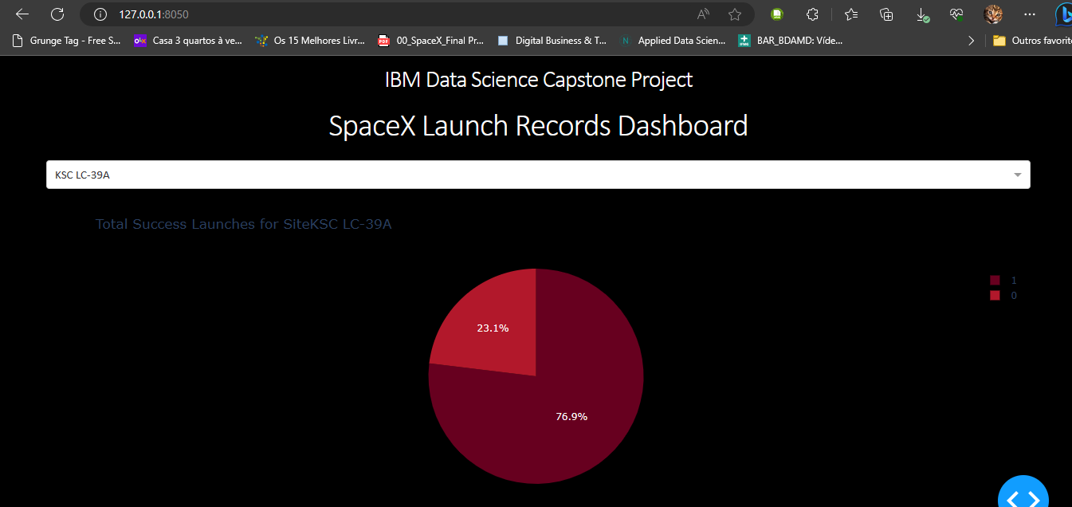
KSC LC-39A has the highest success rate among launch sites at 76.9%.

Slide 40
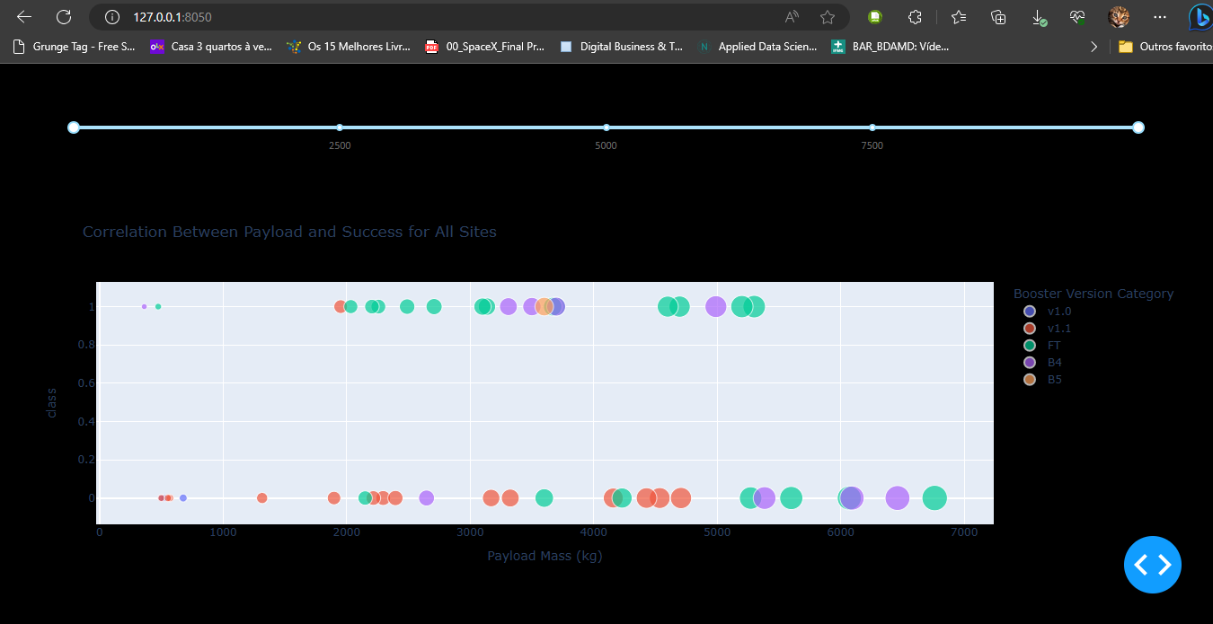
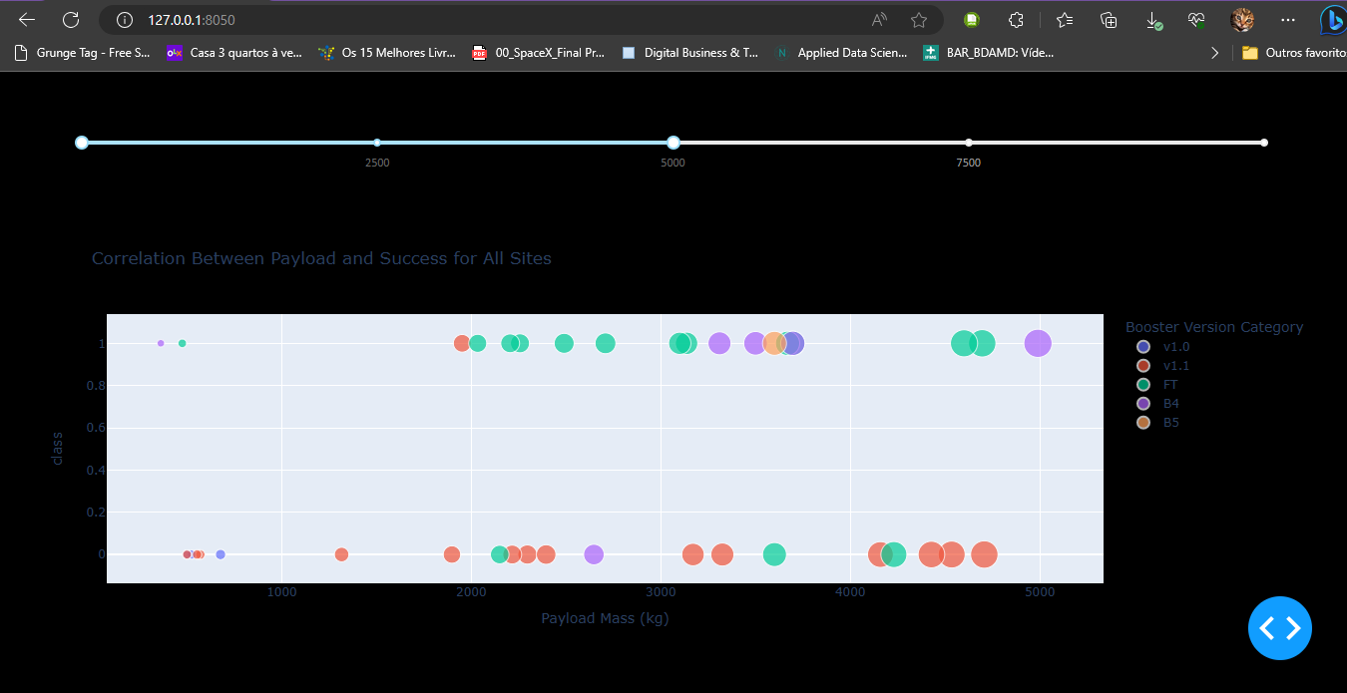
BoosterVersion
Payloads between 2000 kg and 5000 kg have the highest success rate

Slide 41
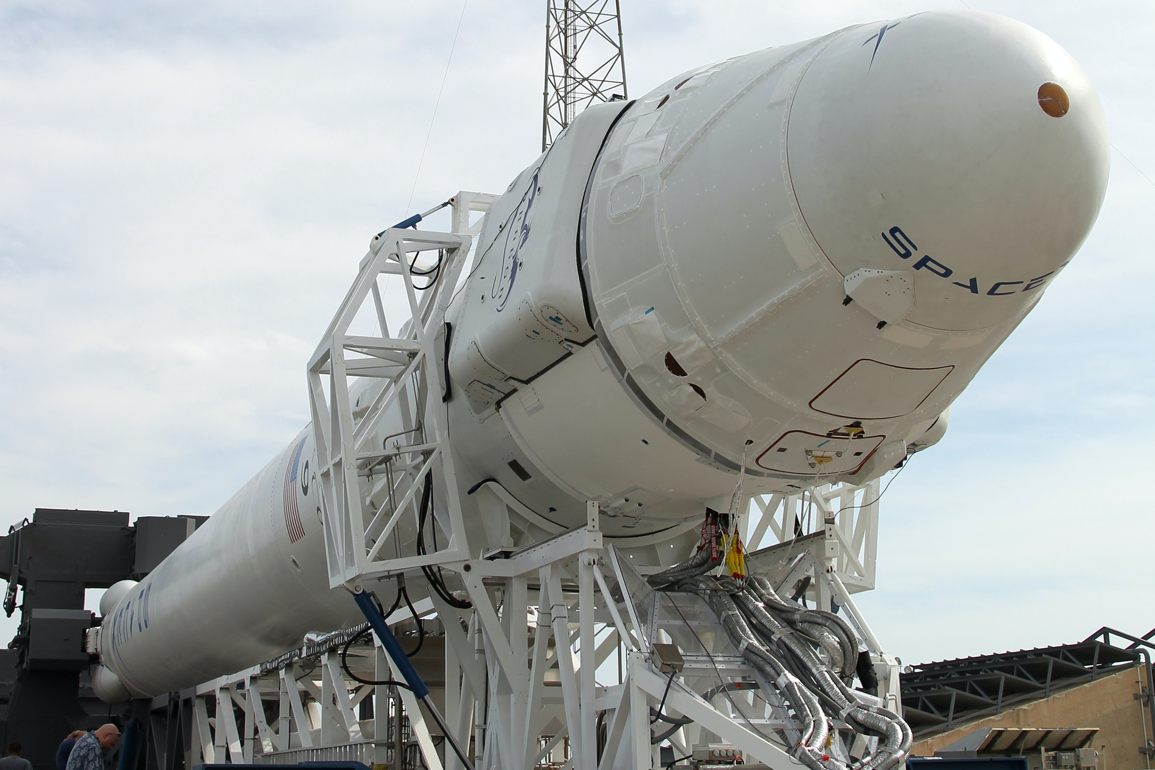
PREDICTIVE ANALYSIS (CLASSIFICATION)

Slide 42
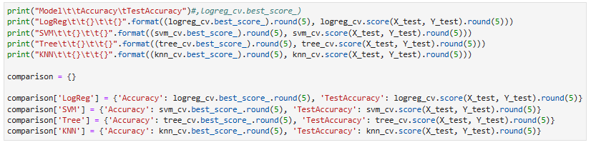
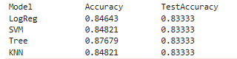
CLASSIFICATION ACCURACY USING TRAINING DATA
The accuracy is extremely close, the models performed approximately the same level of performance and had the same scores and accuracy but, the Decision Tree model outperformed the rest when looking at .best_score_

Slide 43

CONFUSION MATRICES
The confusion matrix, which summarizes the performance of a classification algorithm in this case, had identical results in all matrices.
Both had a false positive (type 1 error), which is not good.
Results:
• 12 true positives
• 3 true negatives
• 3 false positives
• 0 False Negative

Slide 44
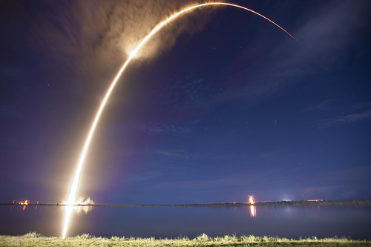
CONCLUSION

Slide 45
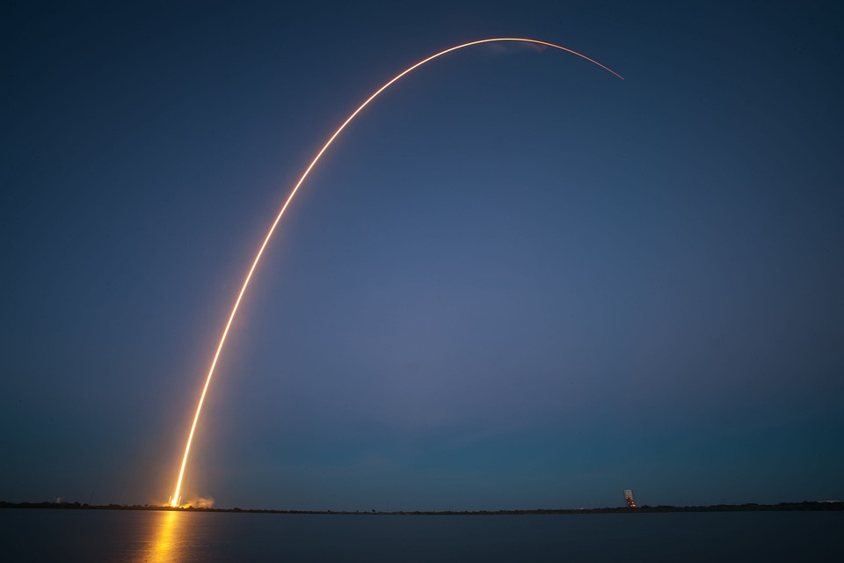
CONCLUSION
Highest success rate among launch sites.
KSC LC-39A:
100% success rate for launches under 5,500 kg.
Most launch sites are close to the Equator, because the Earth's rotation speed is greater than in any other part of the planet - and this makes the rockets gain an extra boost, saving fuel.
EQUATOR:
ORBITS:
ES-L1, GEO, HEO and SSO have a 100% success rate
Launch success Increases over time
All the launch sites are close to the coast
LAUNCH
At all launch sites, the greater the payload mass (kg), the higher the success rate.
ES-L1, GEO, HEO and SSO have a 100% success rate

